Slide 1
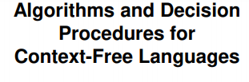
Module 4

Slide 2
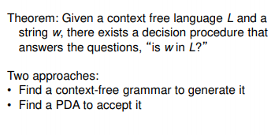
Decidability of CFLs

Slide 3
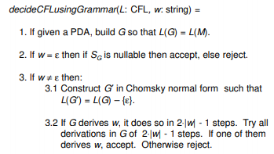
Using a Grammar to decide

Slide 4
Using a PDA to decide
Two step approach:
For every context free language L, it is possible to build a PDA that accepts L-{Є}
Every PDA with no Є -transitions is guaranteed to halt.

Slide 5


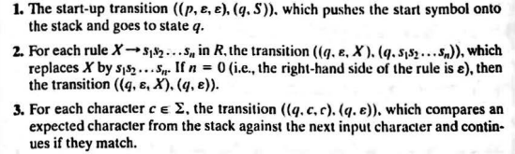
Elimination of Є-transitions

Slide 6
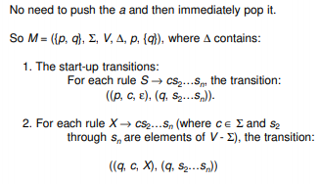
Elimination of Є-transitions

Slide 7

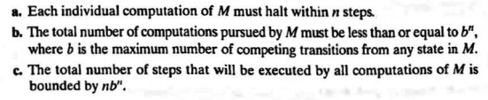
Halting behaviour of PDAs without Є-transitions

Slide 8
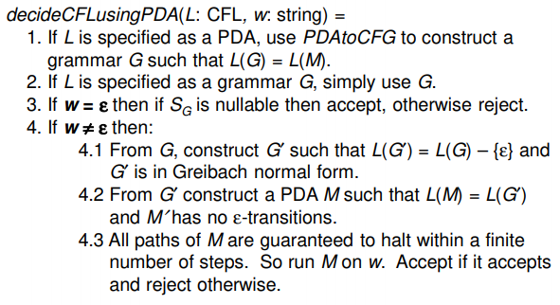
An algorithm to decide whether M Accepts W

Slide 9
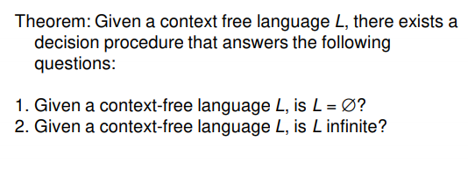
Decidability of Emptiness and Finiteness

Slide 10


Slide 11
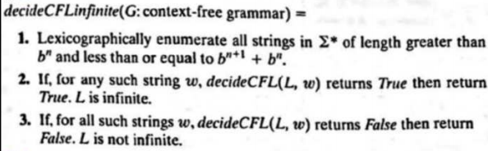

Slide 12
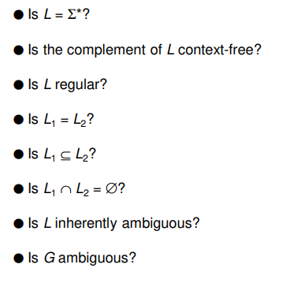
The Undecidable questions about CFLs

Slide 13
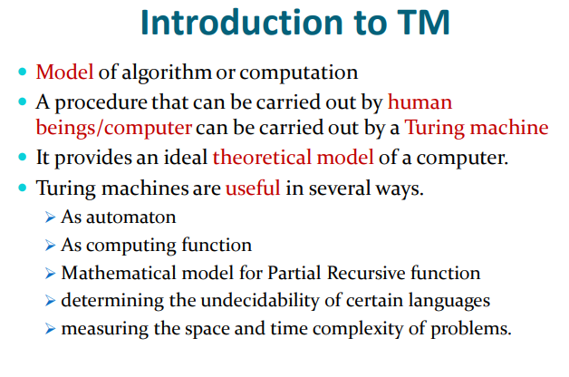

Slide 14
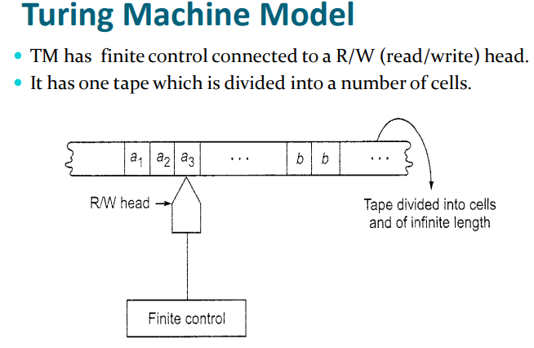

Slide 15
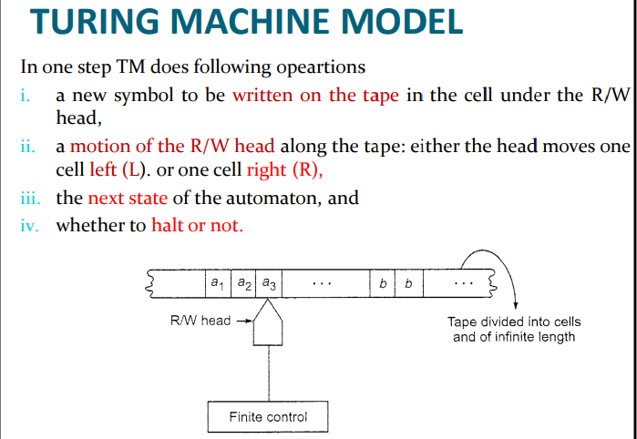

Slide 16
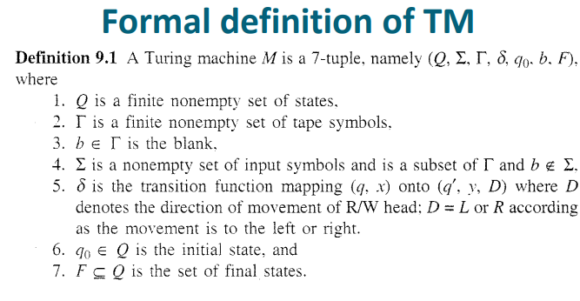

Slide 17
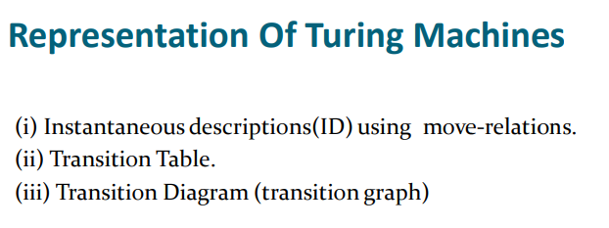

Slide 18
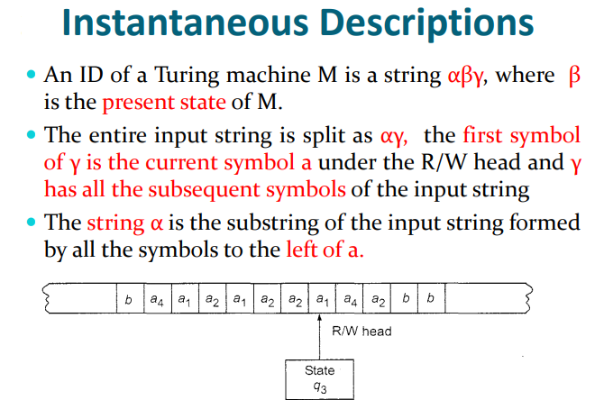

Slide 19
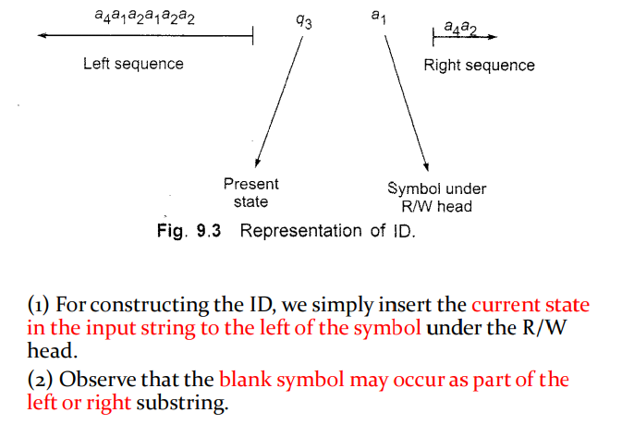

Slide 20
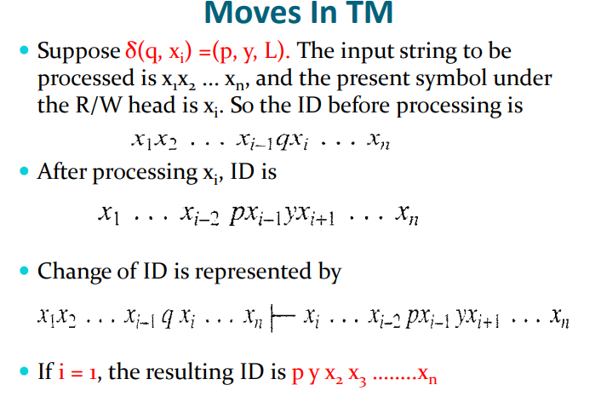

Slide 21
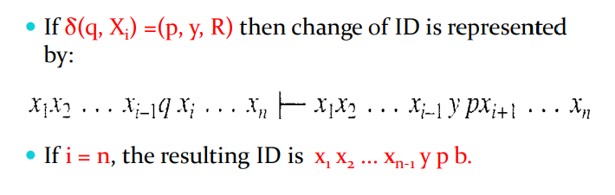

Slide 22
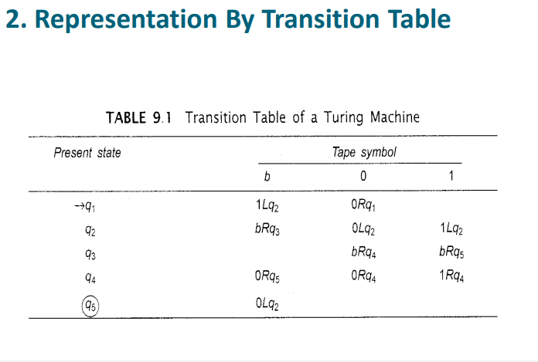

Slide 23
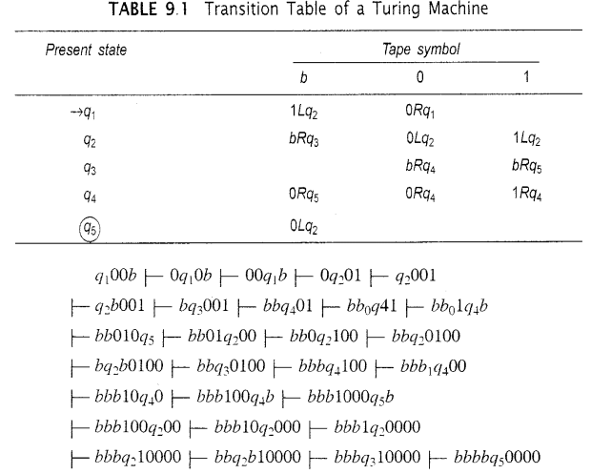

Slide 24
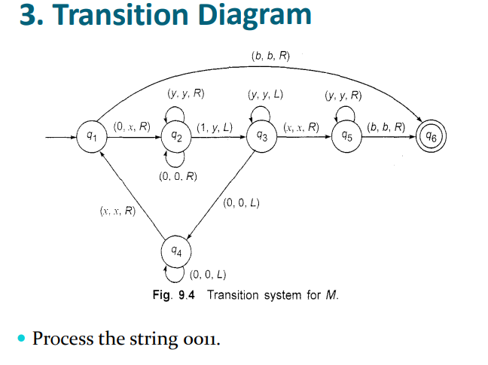

Slide 25
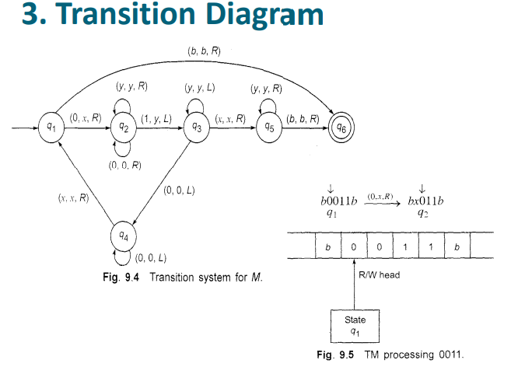

Slide 26
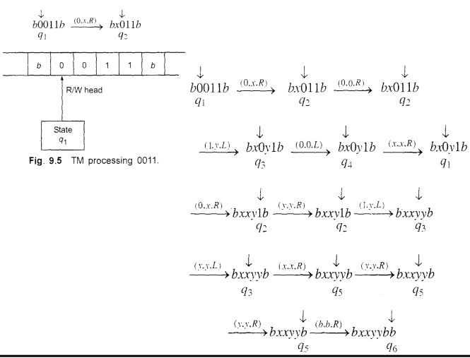

Slide 27
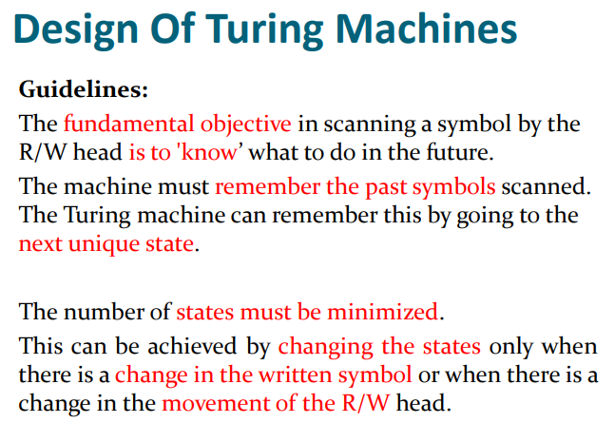

Slide 28
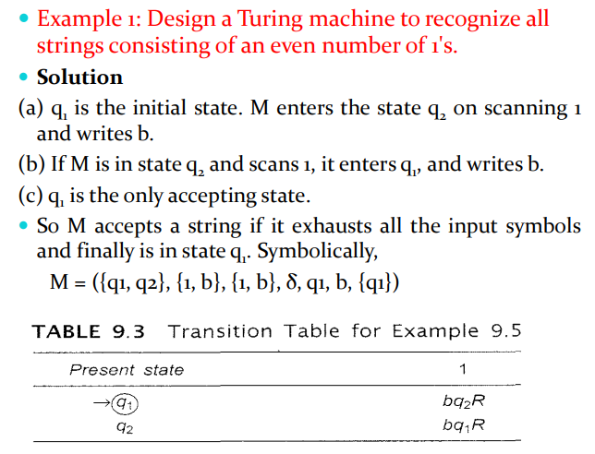

Slide 29
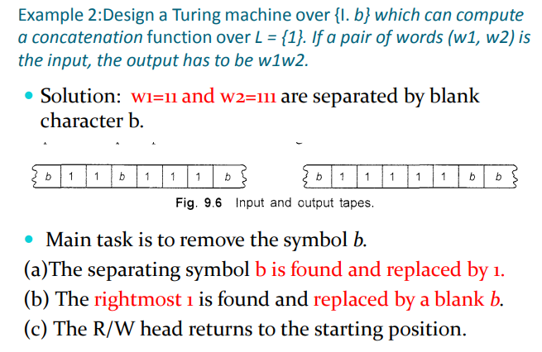

Slide 30
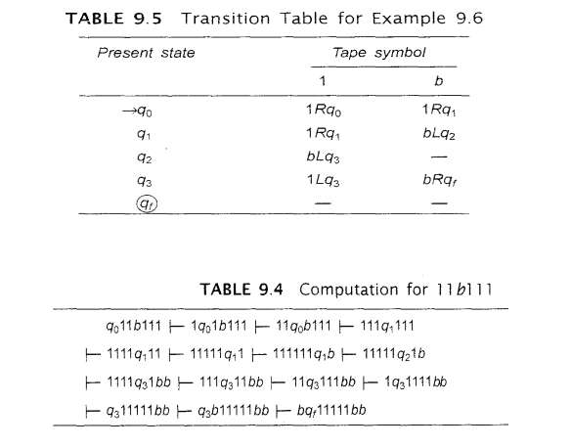

Slide 31
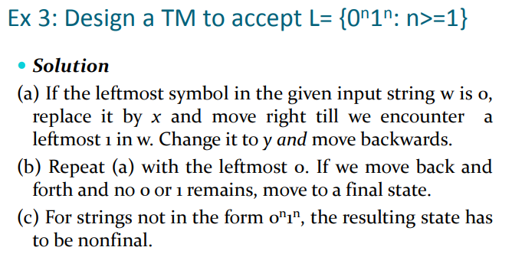

Slide 32
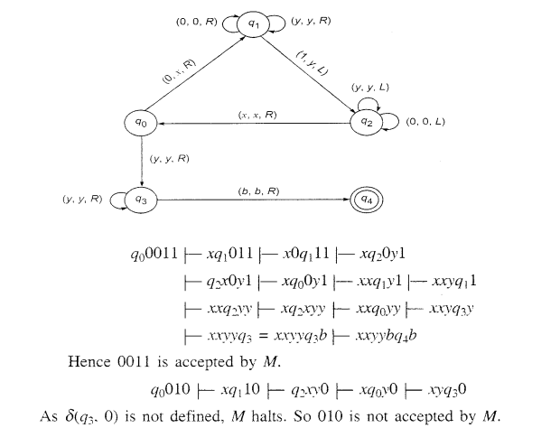

Slide 33
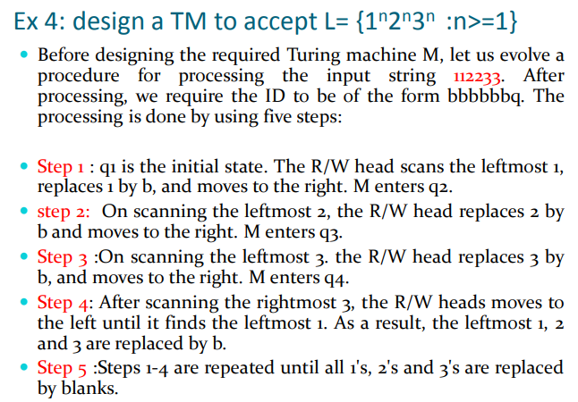

Slide 34
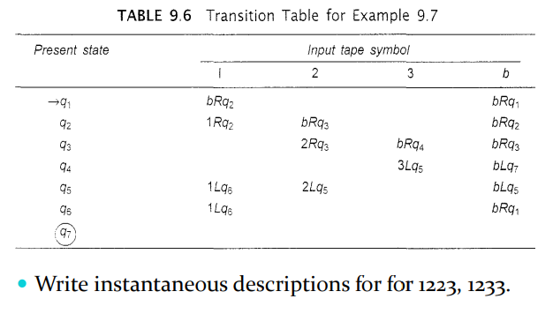

Slide 35
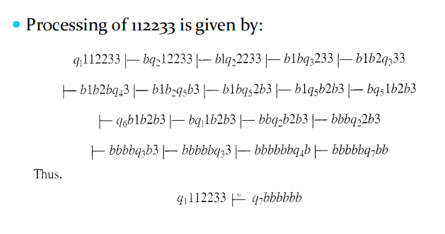

Slide 36
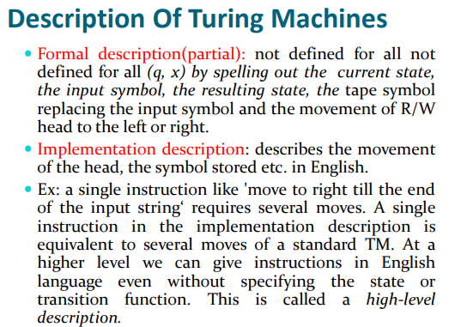

Slide 37
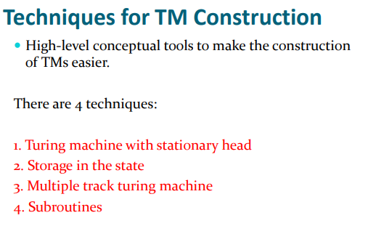

Slide 38
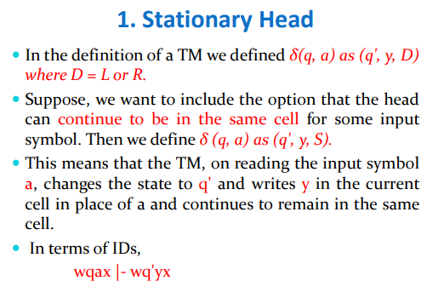

Slide 39
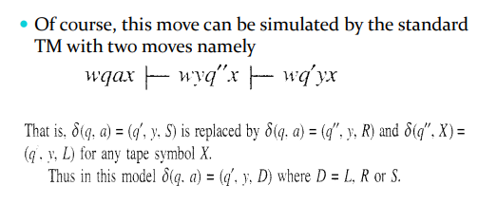

Slide 40
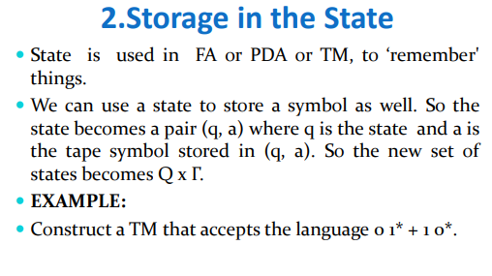

Slide 41
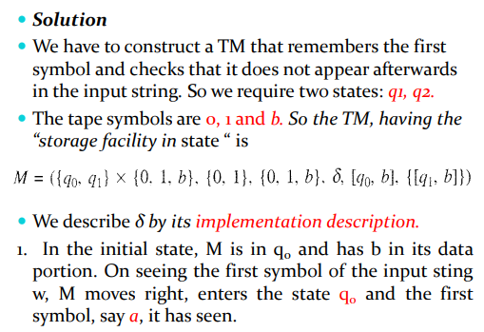

Slide 42
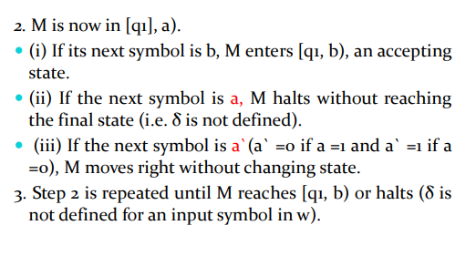

Slide 43
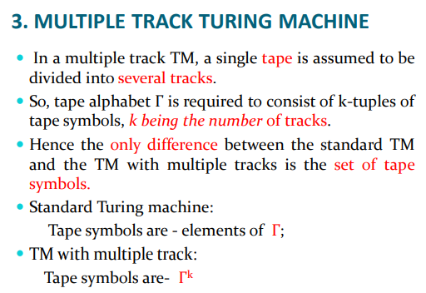

Slide 44
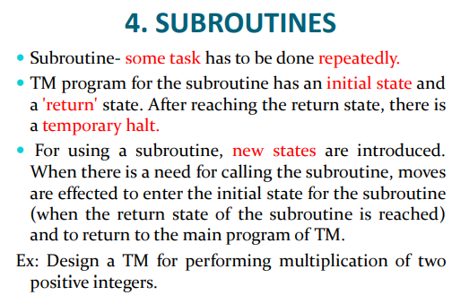

Slide 45
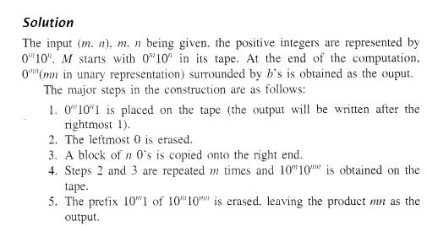

Slide 46
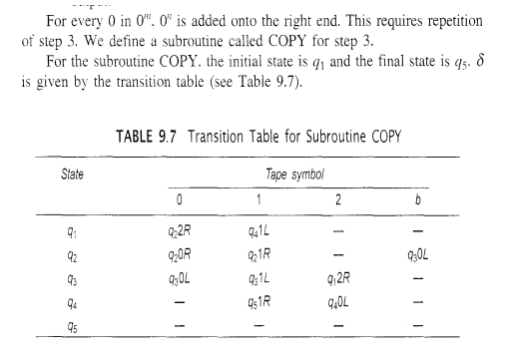

Slide 47
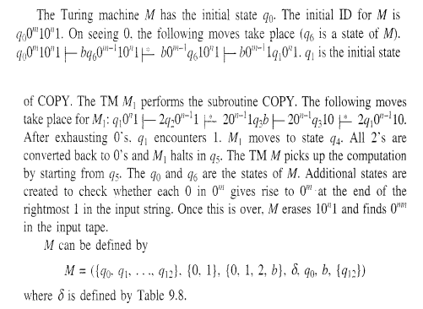

Slide 48
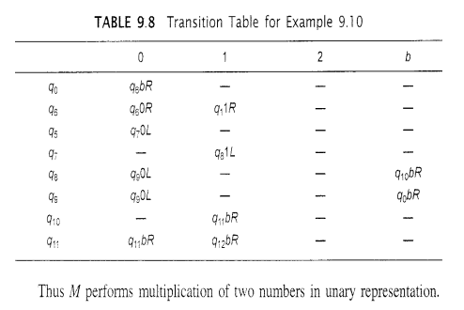

Slide 49
Variants of Turing Machines
Two new models of TM:
Multi tape Turing machine
Nondeterministic Turing machine

Slide 50
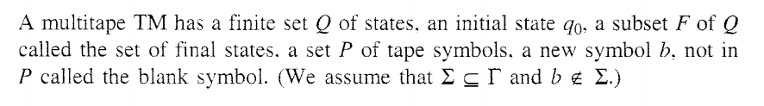
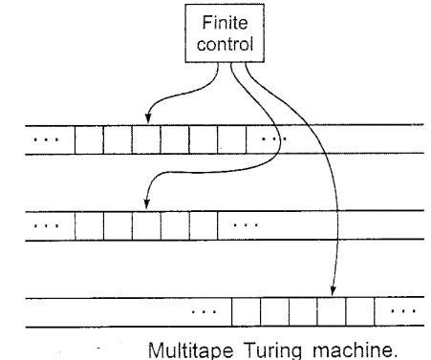
Multitape Turing Machine

Slide 51
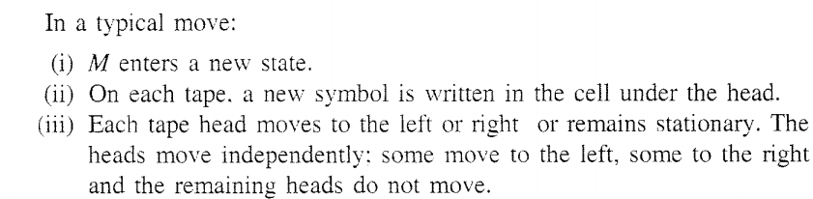

Slide 52
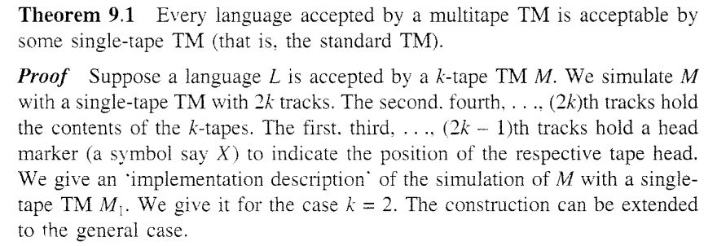


Slide 53


Nondeterministic Turing Machine

Slide 54



Slide 55



Slide 56

The model of Linear Bounded Automaton
This model is important because:
Set of context-sensitive languages is accepted by the model
The infinite storage is restricted in size but not in accessibility to the storage in comparison with TM model. –Linear Bounded Automaton
A linear bounded automaton is a nondeterministic Turing machine which has a single tape whose length is not infinite but bounded by a linear function of length of the input string. The model can be described formally by the following set format:

Slide 57


Slide 58
Relation between LBA and Context-sensitive languages

